Slide 1

Capstone Project : Sales Analytics
Northwind Dataset

Slide 2
Introduction to the Dataset
The dataset simulates a small international trading company that imports and exports specialty foods from around the world.
Tables used -
Orders: Order-level details including dates, customer, employee, and shipping info.
Order_Details: Line items in each order with product ID, quantity, unit price, and discount.
Customers: Customer profiles including location and company details.
Employees: Sales representatives and their reporting structure.
Products: Inventory data with pricing, stock levels, and supplier references.
Suppliers: Information about product suppliers including location and contact details.
Categories: Product categories like Beverages, Dairy Products, etc.
Shippers: Shipping companies responsible for delivering orders.

Slide 3
Project Objectives
Primary Goal -
Perform deep Exploratory Data Analysis (EDA) and business intelligence using SQL , Power BI and Excel
Key Objectives -
Extract actionable insights to aid business decision-making.
Analyze performance metrics related to sales, suppliers, customers, and products.
Build dashboards for effective visualization and storytelling.

Slide 4
Scope and Area of Focus
Sales & Revenue Analysis -
Understand product performance, top revenue drivers, and outlier detection.
Customer Behaviour -
Segment customers based on frequency and value of orders.
Supplier & Procurement Analysis -
Evaluate supplier trends, pricing, and reorder levels.
Visualization -
Use Excel Dashboards and Power BI to communicate findings clearly.

Slide 5
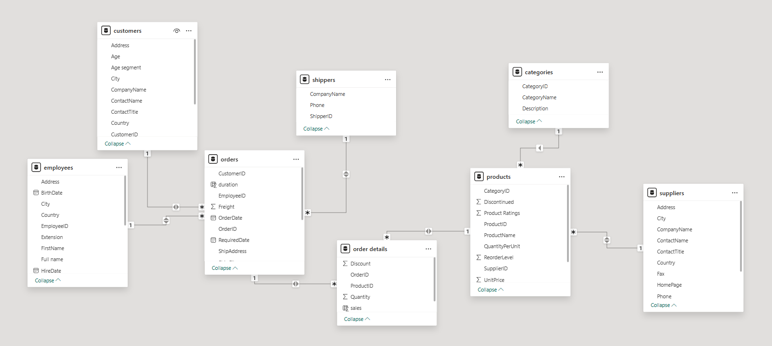
Data Model

Slide 6
Power BI Questions

Slide 7
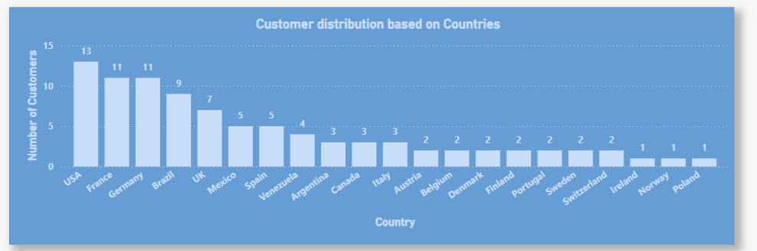
How does customer distribution vary across different regions or customer segments? Can we visualize it on a map or bar chart?
Customer distribution is highest in the USA, France, and Germany, indicating strong market presence in these regions. The noticeable decline in other countries presents an opportunity to explore growth in the markets.

Slide 8
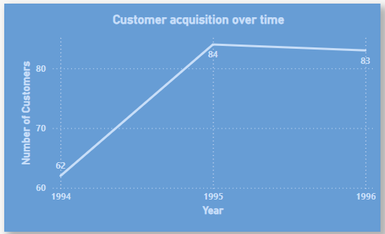
What is the trend in customer acquisition over time? Can we create a line chart or area chart to display it?
We can notice a good customer acquisition growth from 1994 – 1995 and a little decline the consecutive year. Suggesting the opt some of the same strategies used in the previous year.

Slide 9
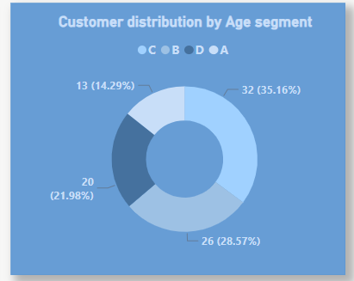
Can we visualize the distribution of customer demographics such as age, gender, or income using histograms or pie charts?
The Age segments have been divided as A being the youngest and D being the oldest. So, we can clearly see that middle- aged audience has the maximum proportion in this distribution.

Slide 10
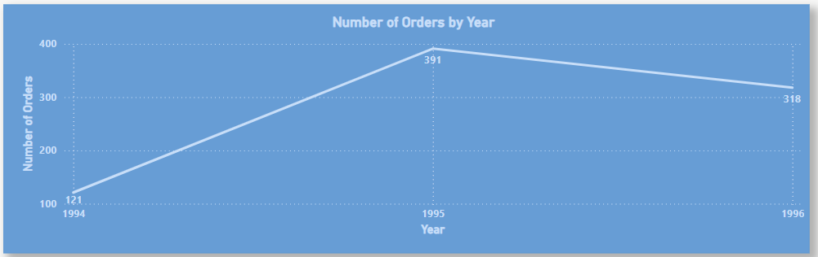
How does order volume change over time? Can we create a time series chart or stacked bar chart to visualize it?
We can notice a really high order growth from 1994 – 1995 and a little decline the consecutive year. Suggesting the opt some of the same strategies used in the previous year.

Slide 11
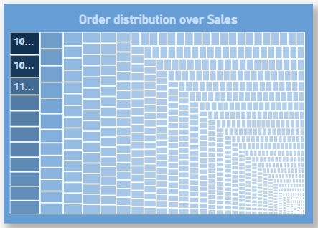
What is the distribution of order values? Can we create a histogram or box plot to display it?
Since box-plot was not available, we used a tree map instead. This visualization shows there are not much number of orders with a sales value higher than the others.

Slide 12
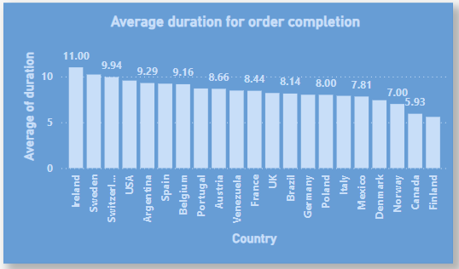
Can we visualize the average order processing time or shipping duration using a bar chart or box plot?
This visualization shows the average duration in days to complete and deliver on order for countries. Suggesting that there is a scope of work in many countries taking more than a week to complete an order.

Slide 13
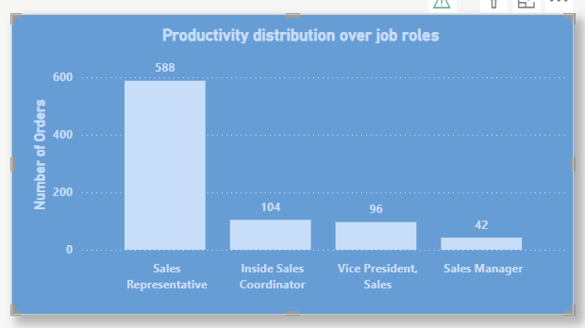
How does employee productivity vary across different departments or job roles? Can we create a stacked bar chart or grouped column chart to visualize it?
This visualization shows the number of orders handled by employees grouped by their job role, which clearly shoes us the involvement of Sales Representative’s are much more than other job roles .

Slide 14
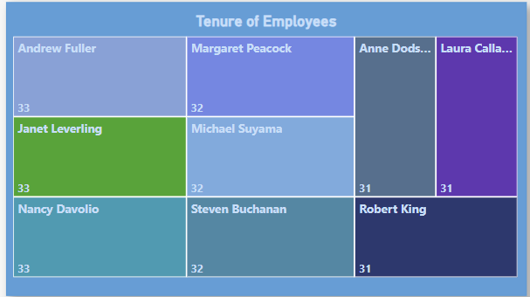
What is the distribution of employee tenure? Can we create a histogram or box plot to display it?
This visualization shows the working duration (in years) for each employee in the company.

Slide 15
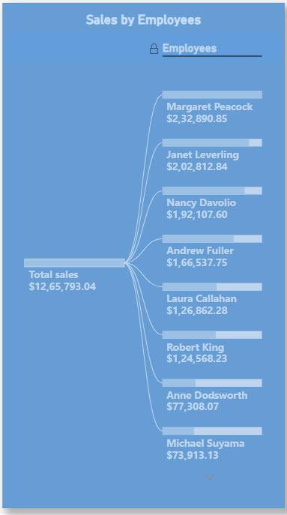
Can we visualize employee performance ratings or KPIs using a radar chart or bullet graph?
This visualization shows the Sales (performance) for each employee. This information can be useful when there is some decision to make about best performing employees.

Slide 16
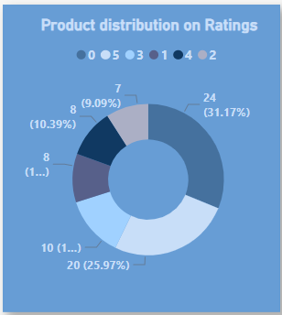
What is the distribution of product ratings or reviews? Can we create a histogram or stacked bar chart to visualize it?
This visualization shows the number of products for each product rating. Thid information can be used to make informed decisions regarding products in order to increase productivity of sales in the company.

Slide 17
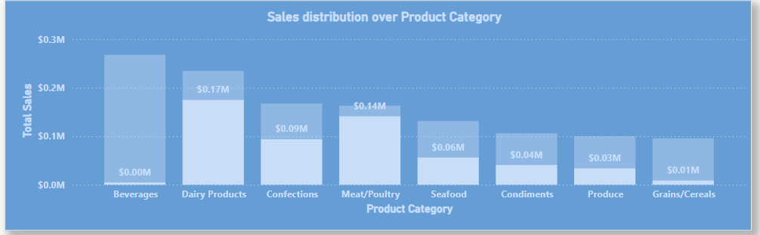
How does the sales volume vary across different product categories? Can we create a bar chart or treemap to display it?
This is a perfect way to visualize sales revenue for different product categories. Here, we can clearly see that two categories are doing a lot better than the other, suggesting to take informed actions in marketing strategies.

Slide 18
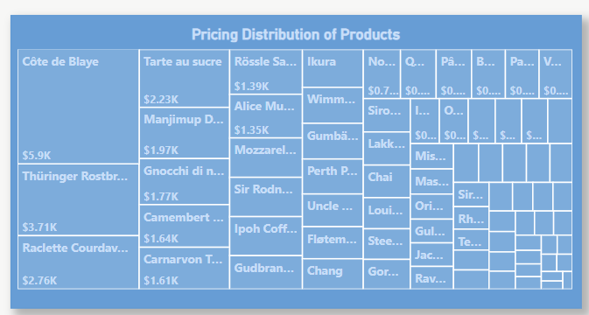
Can we visualize the pricing distribution of products using a box plot or violin plot?
The treemap visualizes a few high-priced products dominating the pricing distribution. Most other products fall into a much less priced segment when compared to them.

Slide 19
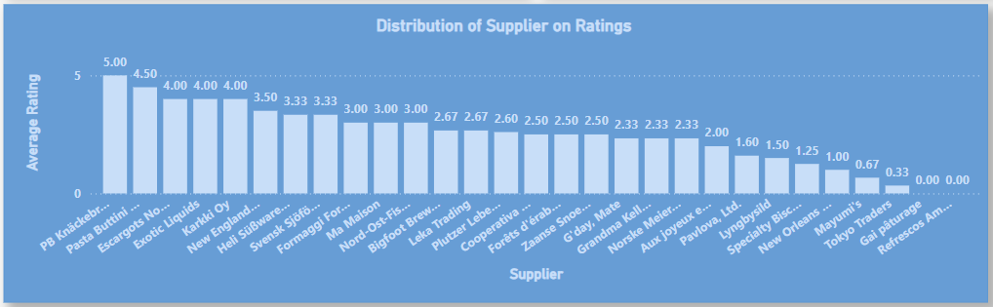
What is the distribution of supplier ratings or performance metrics? Can we create a bar chart or radar chart to visualize it?
The visualization shows ratings for each supplier. Showing only one supplier with a complete rating of 5. The ratings are based on the fact that how well did the products performed supplied by the respective supplier.

Slide 20
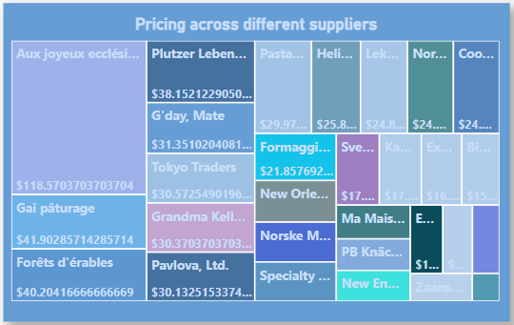
How does the cost or pricing structure vary across different suppliers? Can we create a box plot or stacked bar chart to display it?
The treemap indicates that one supplier stands out with a much higher price compared to the rest, charging nearly three times more. The majority of suppliers have similar prices, indicating a fairly balanced and competitive market.

Slide 21
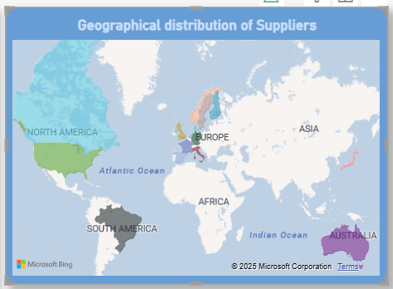
Can we visualize the geographical distribution of suppliers using a map or bubble chart?
The map shows the geographical location of suppliers. Also, we can see that there are no suppliers in Africa and Asia(other than Japan). Suggesting a possibility to reach out to suppliers in the region in order to decrease shipping cost and time.

Slide 22
EDA Questions

Slide 23
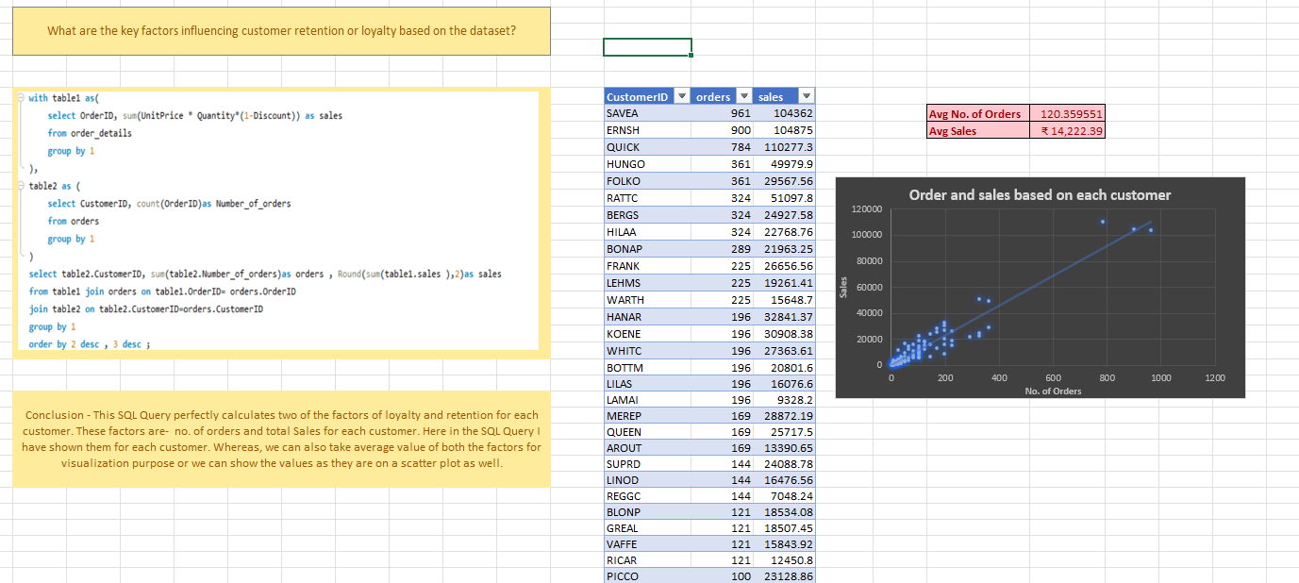

Slide 24
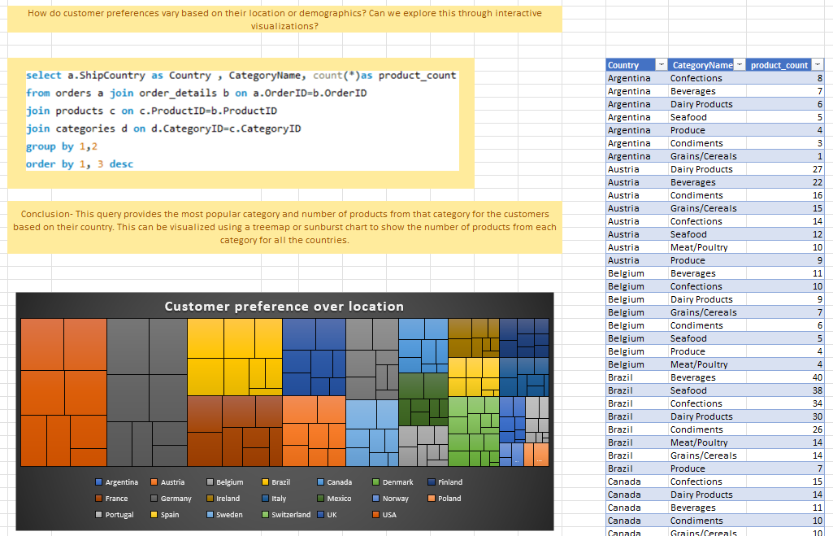

Slide 25
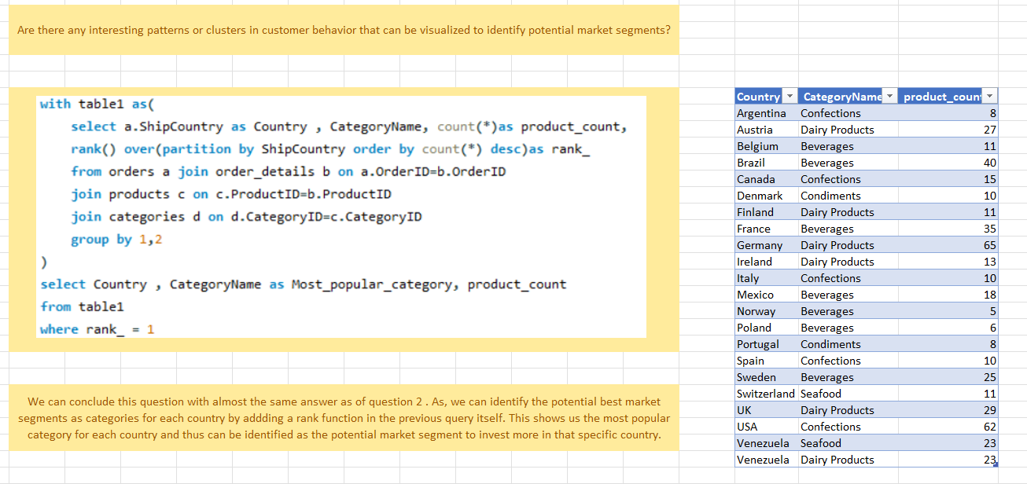

Slide 26
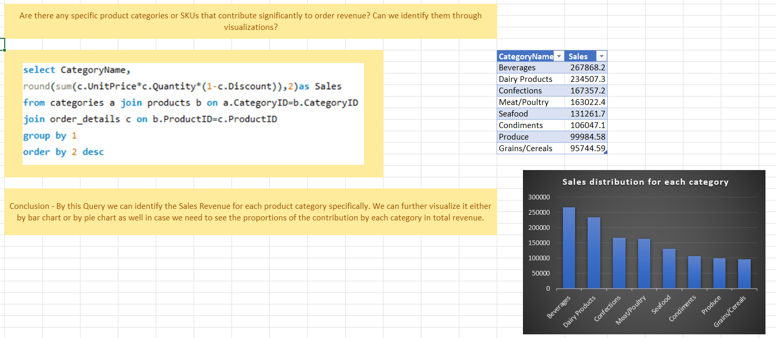

Slide 27
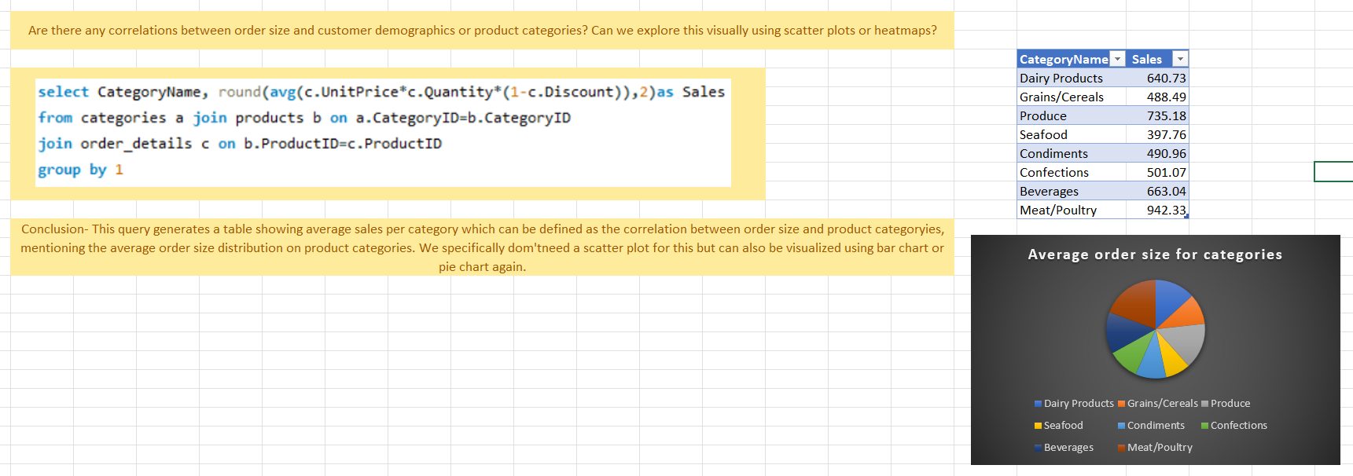

Slide 28
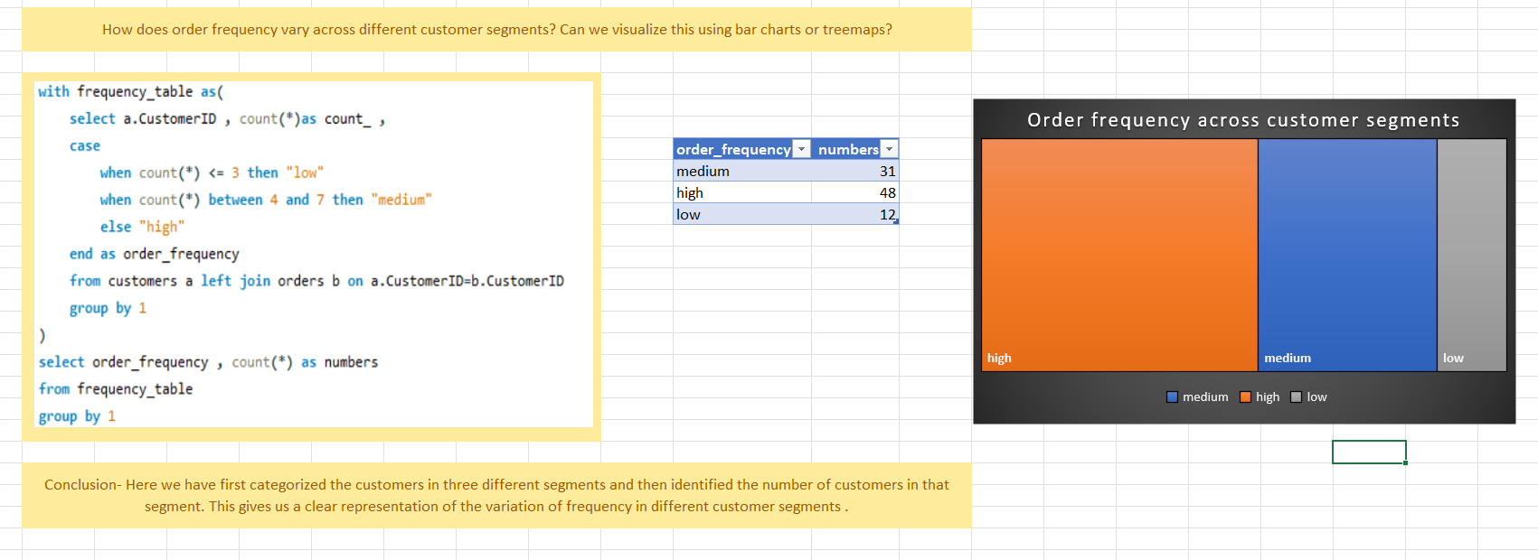

Slide 29
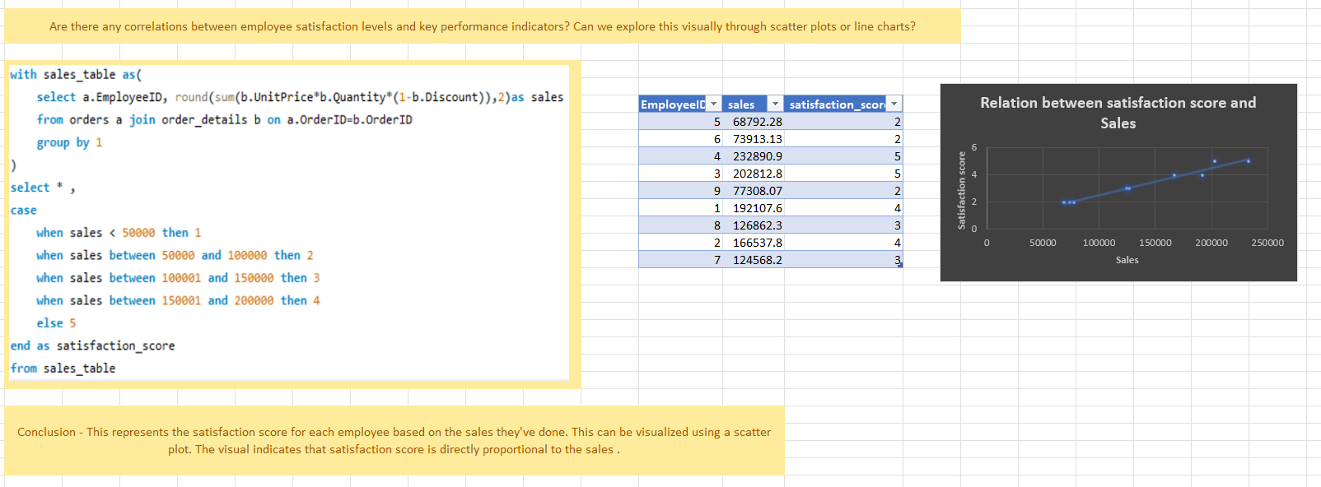

Slide 30
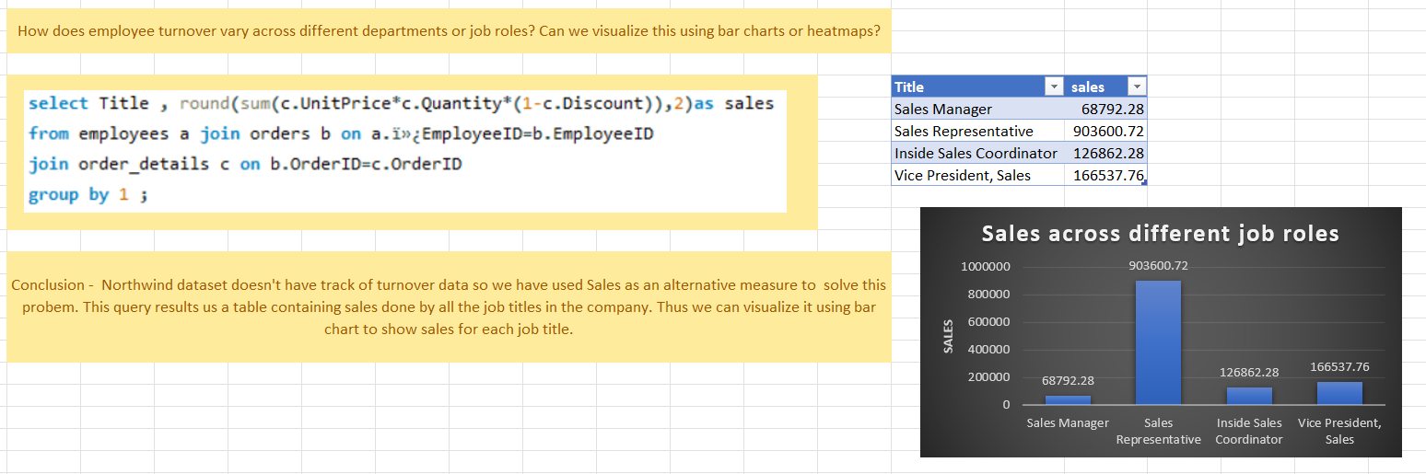

Slide 31
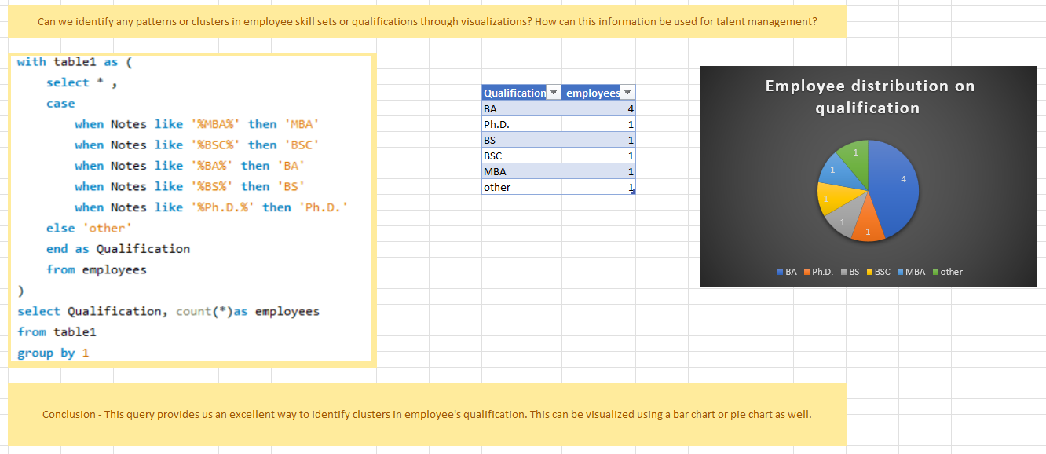

Slide 32
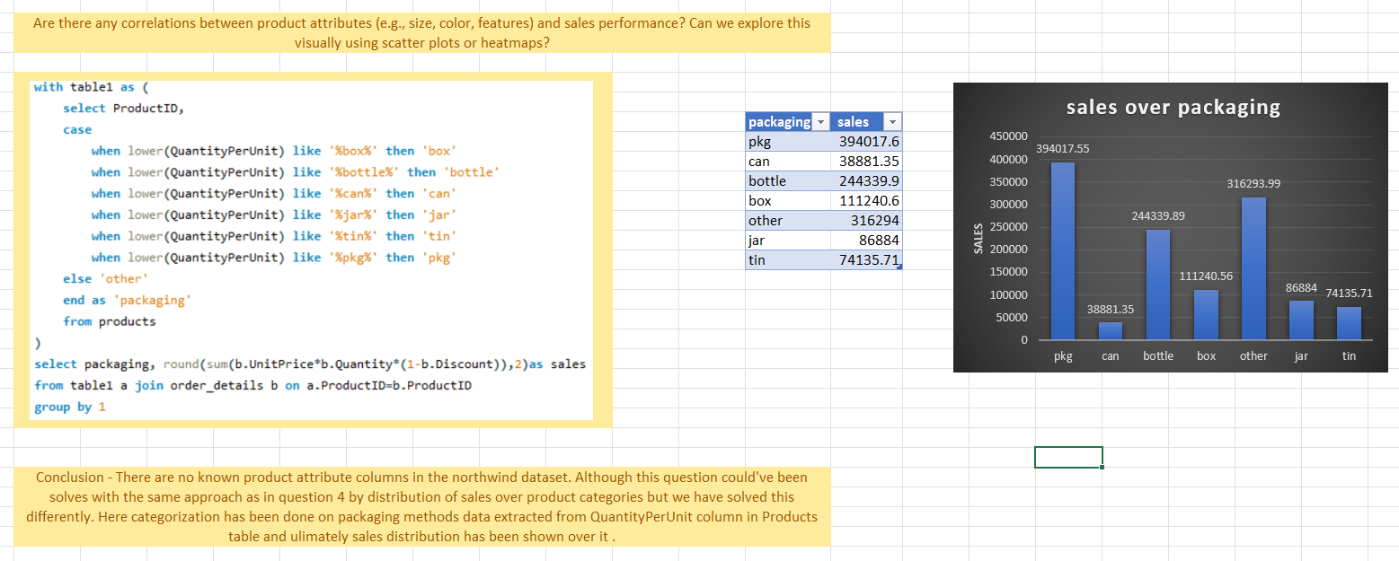

Slide 33
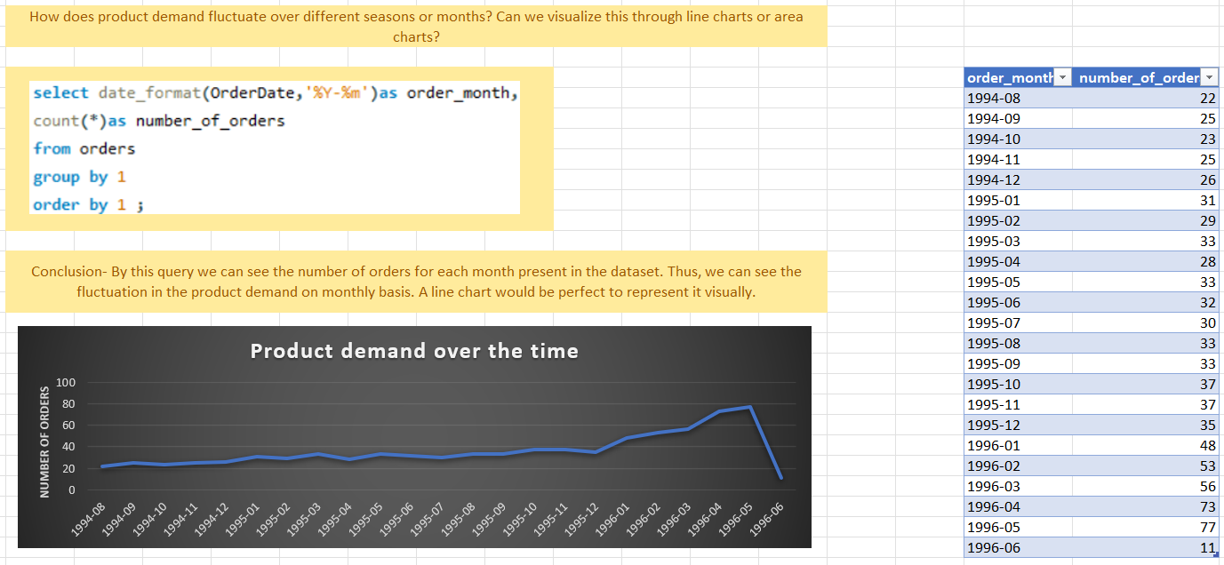

Slide 34
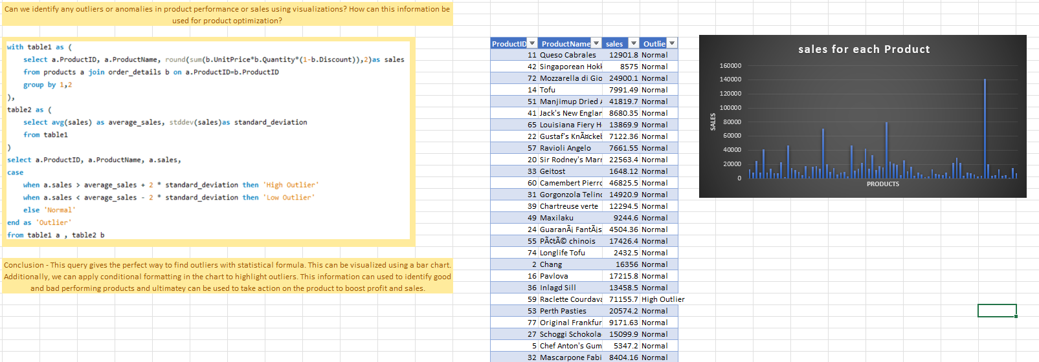

Slide 35
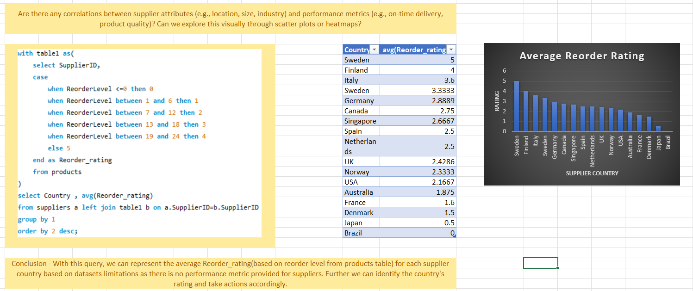

Slide 36
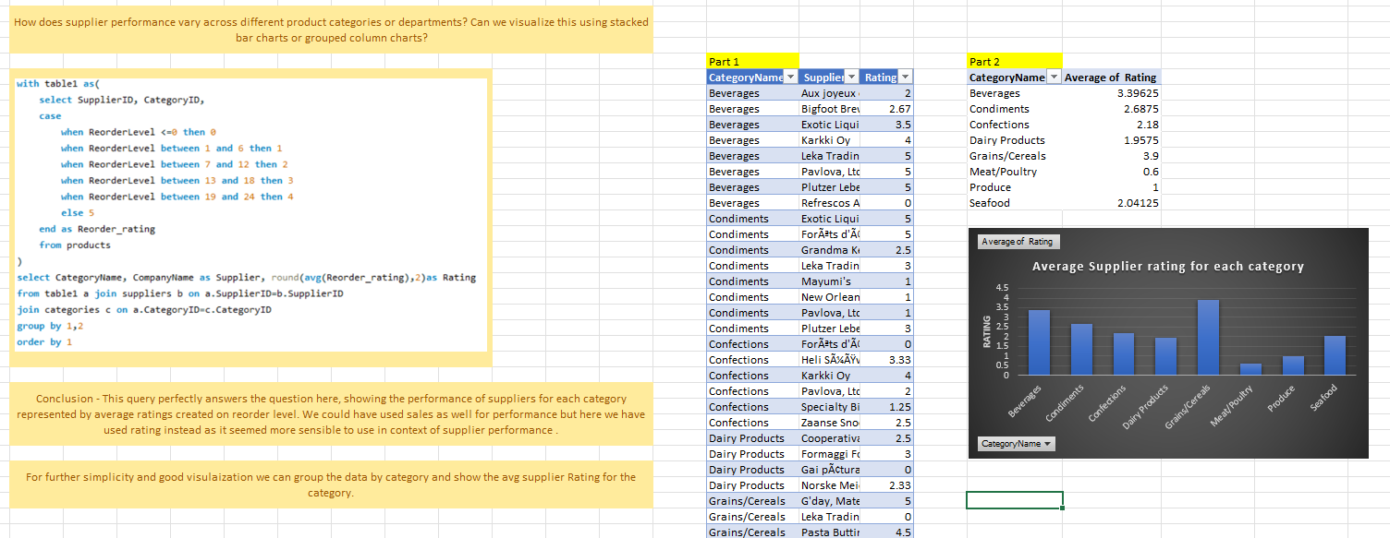

Slide 37
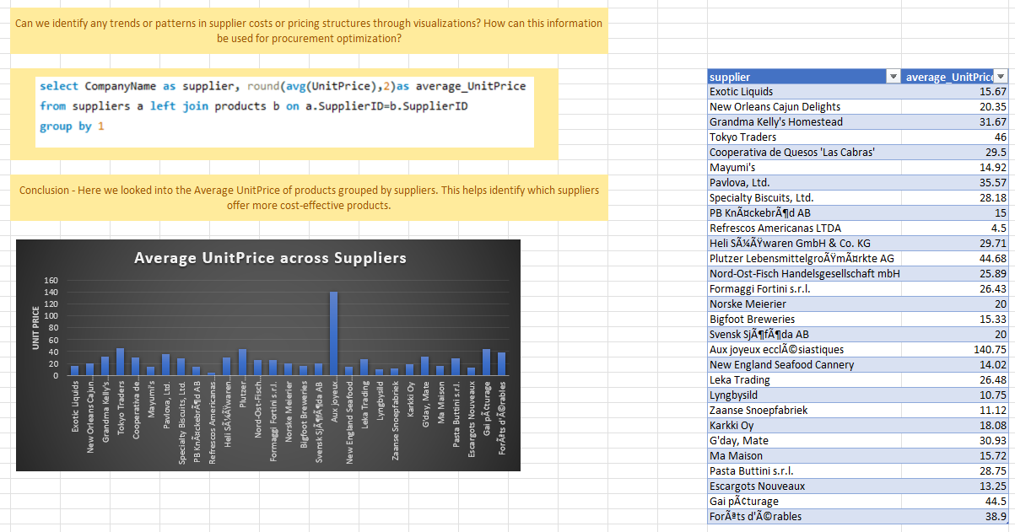

Slide 38
